Slide 1
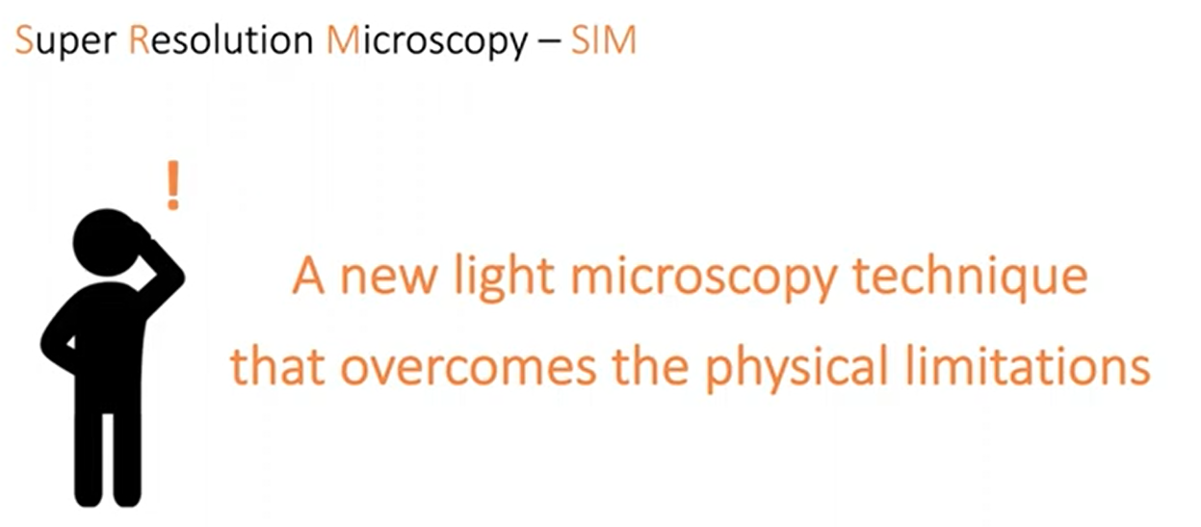
SUPER-RESOLUTION MICROSCOPY

Slide 2
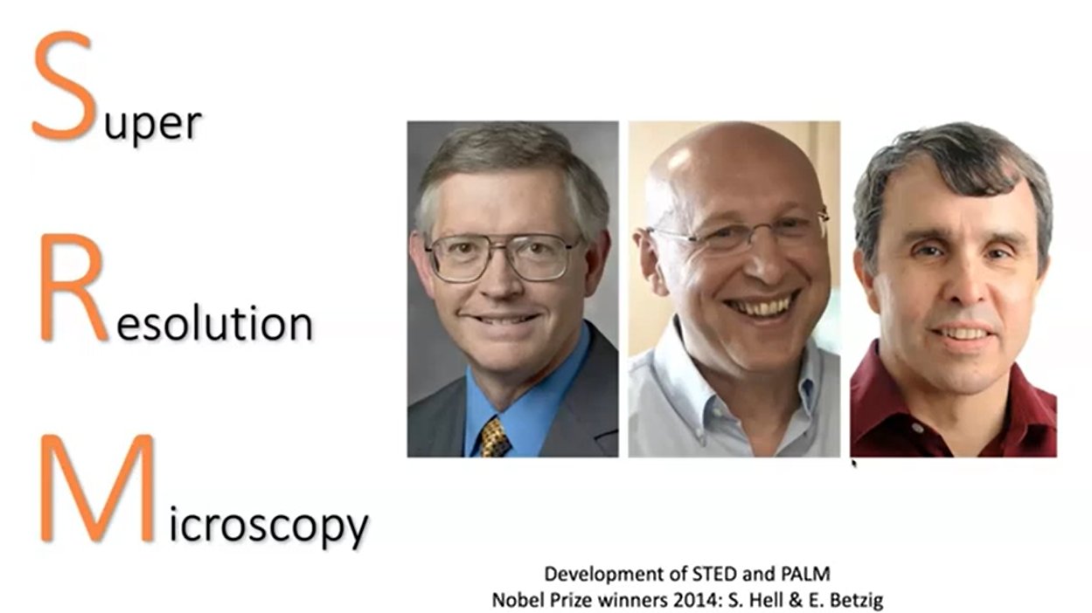
SUPER-RESOLUTION MICROSCOPY
Super-Resolution Microscopy Developed by STED and PALM.
They got Nobel Prize in 2014.

Slide 3
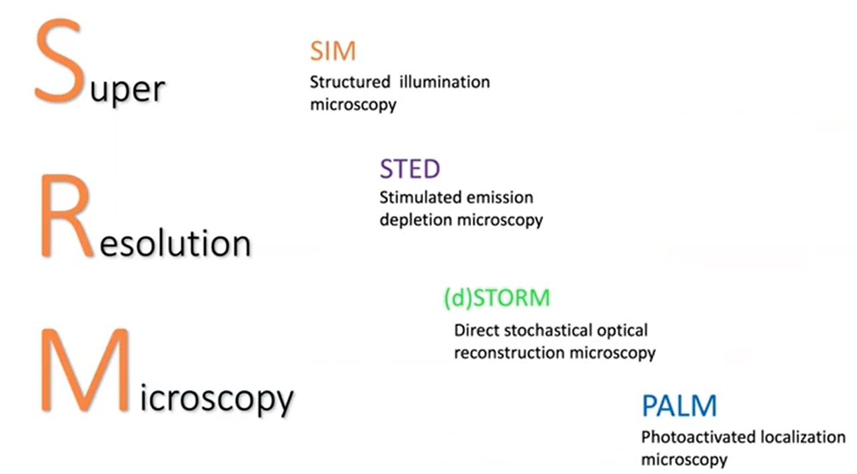
These Scientists Developed Different Types of Super-Resolution In Microscopy

